Slide 1

University of New Brunswick | UNB
Title: AI & Heuristics Driven Predictive Analytics for Network Traffic Optimization in 5G Networks
Presenter: Olaoluwa Malachi
(3787306)
CS 6895 Project
8th April, 2025

Slide 2

Background Study
AI & Heuristics Driven Predictive Analytics for Network Traffic Optimization in 5G Networks
5G networks enable high-speed, low-latency, and high-device-density communication by leveraging technologies like mmWave spectrum, massive MIMO (Multiple Input, Multiple Output), and network slicing.
However, increased demand leads to congestion, inconsistent QoS, and inefficient resource utilization.
Traditional rule-based resource allocation fails in dynamic environments.
Key Idea: Use AI (LSTM) + Heuristics to proactively predict traffic and dynamically allocate resources.
Key Takeaway: Intelligent traffic prediction improves efficiency and reliability in 5G networks.

Slide 3
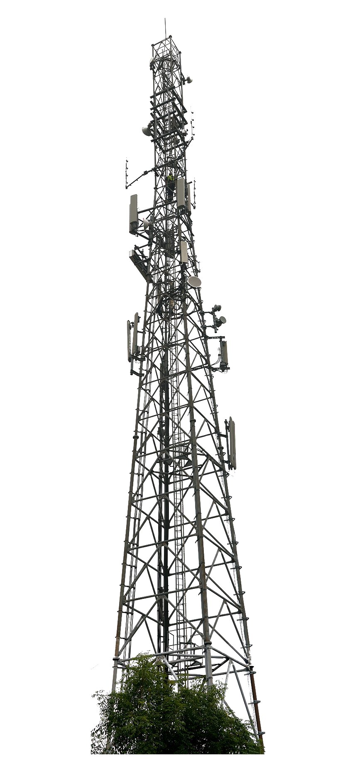
Problem Statement
5G network congestion arises due to:
Diverse and fluctuating user demand
Static or rule-based allocation models
Challenges:
Maintaining low latency and high throughput
Ensuring fairness and reliability across slices
Goal:
Predict traffic trends and optimize slice-level allocation to maintain service quality.

Slide 4
State-of-the-Art Research
Research Gap & Rationale
LSTM is widely used for time-series traffic prediction (Cheng et al., 2021).
Heuristics like genetic algorithms and greedy allocation help optimize networks with low overhead.
Guo et al. (2022) propose hybrid models for balanced AI and real-time optimization.
Few systems combine AI and heuristics into a unified framework that adapts in real-time.

Slide 5
Methodology Overview
Simulation Stack:
Synthetic time-series traffic data
Dynamic resource allocator
Evaluation over multiple metrics
AI Component: LSTM predicts future traffic based on historical data.
Heuristic Component: Dynamically adjusts resource allocation in response to traffic prediction.
Hybrid Approach: Combines long-term forecasting with real-time responsiveness.r better symbol detection.
Generated Data input
LSTM Prediction
Heuristic Allocation
Performance Monitoring

Slide 6
Performance Metrics (Overview)
Resource Utilization (%): Utilized vs. available slice capacity
Latency: Traffic demand / resources allocated
Throughput: max(allocated - demand, 0)
QoS: 1 if allocation ≥ demand; else 0
Energy Efficiency: Allocation / peak usage
Packet Loss: (Sent - Delivered) / Sent
Security Level: 1 - normalized packet loss

Slide 7
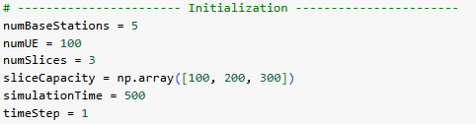
Model Training
A generated data set with trends and pseudo-random patterns that meet the needs of the network constraints, like actual users demand, is used for training the models and evaluating the results.
Implemented in Python using LSTM for forecasting and heuristics for allocation.
Time-series inputs generated and normalized.
Data visualized using Matplotlib for trend detection.
Real-time evaluation loop measures all KPIs.

Slide 8
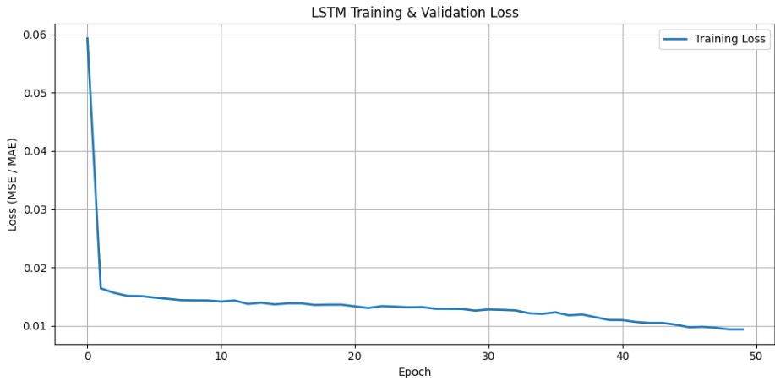
Model Training

Slide 9
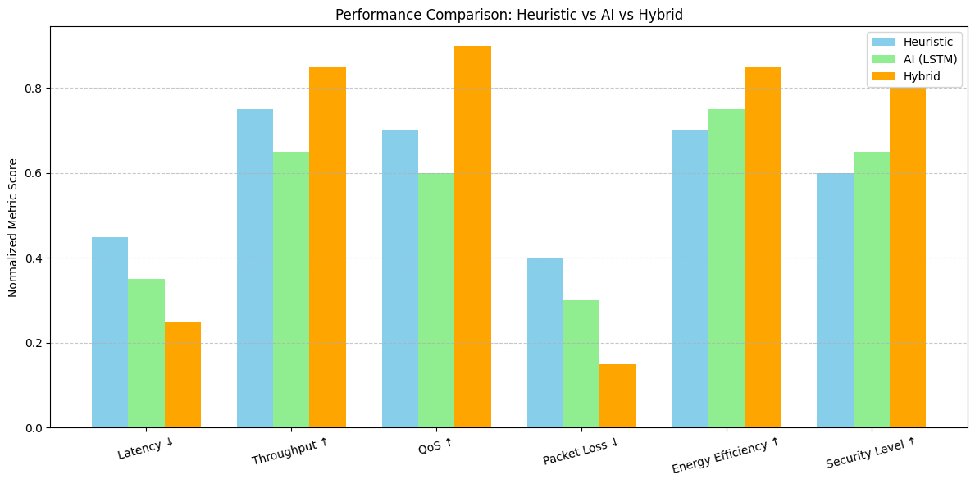
Performance Avg. Comparison Trend: Heuristic vs AI(LSTM) vs Hybrid

Slide 10
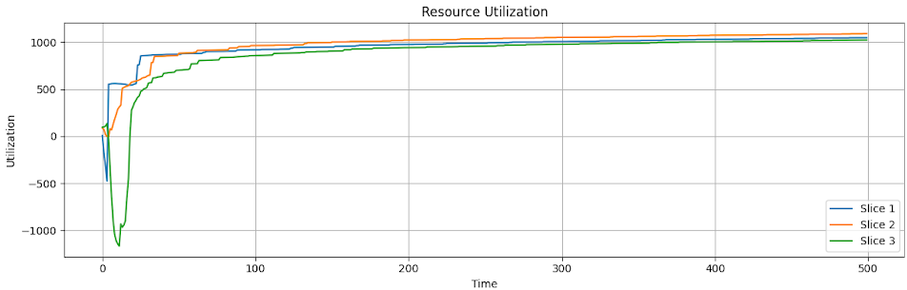
Resource Utilization (over time by slice)

Slide 11
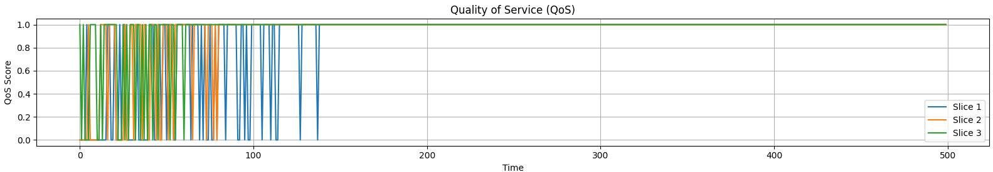
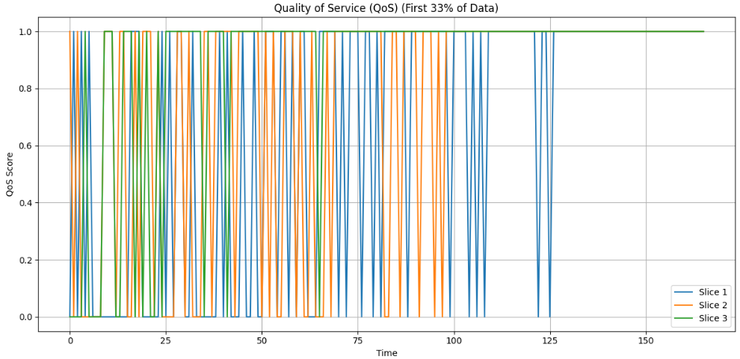
QoS (early 1/3 slice zoom)

Slide 12
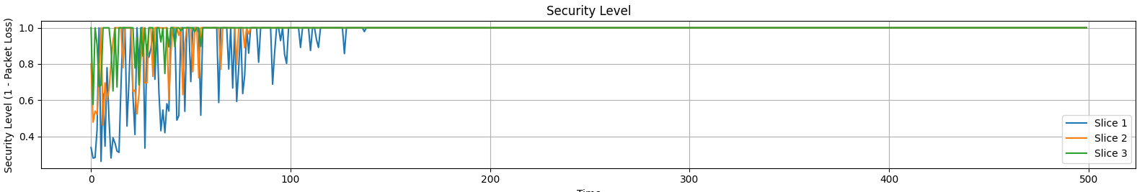
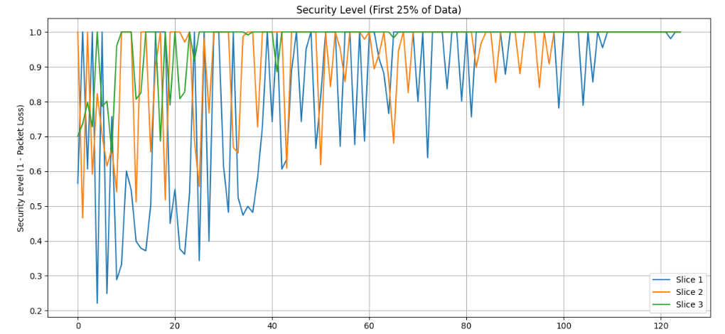
Security Level (early 1/4 slice zoom)

Slide 13
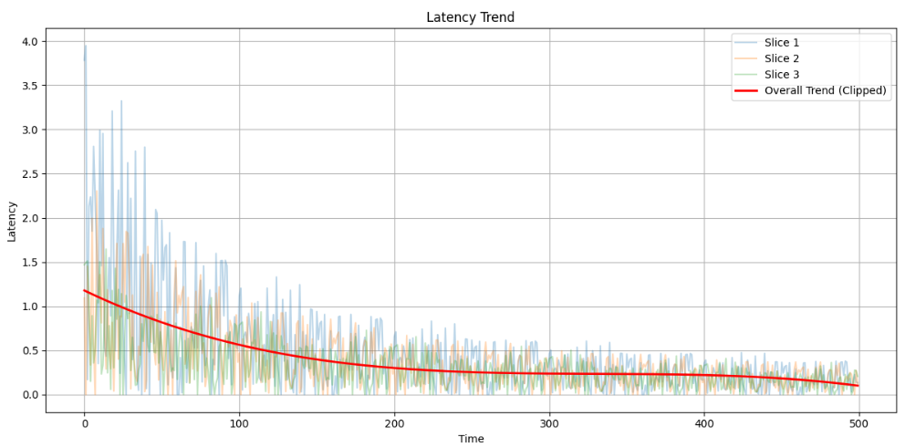
LATENCY

Slide 14
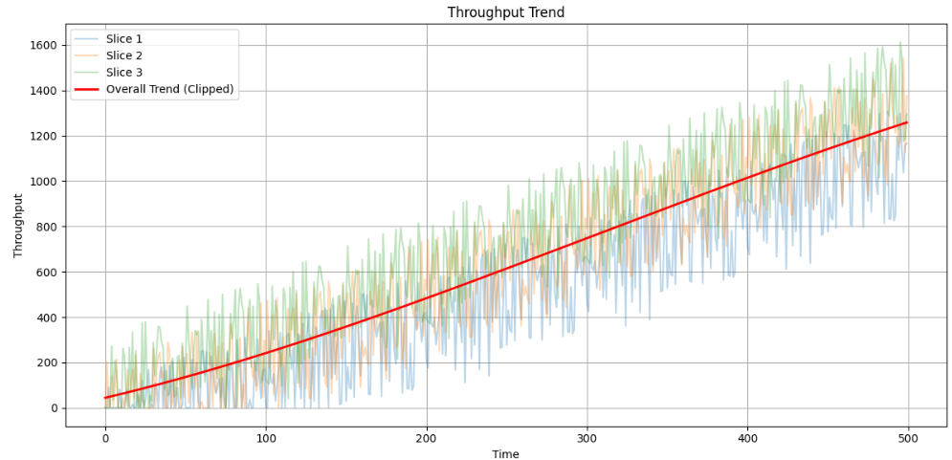
THROUGHPUT

Slide 15
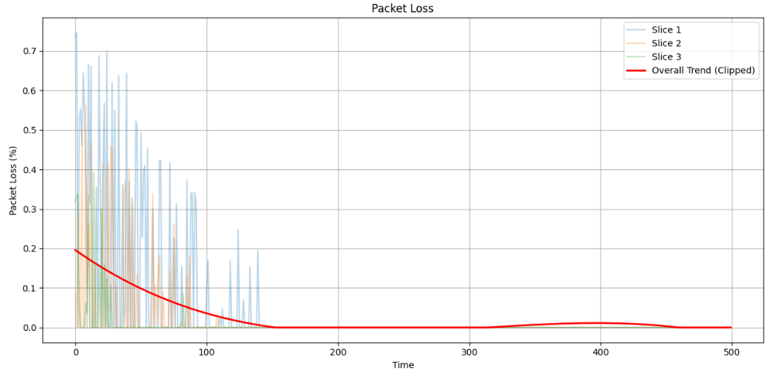
PACKET LOSS

Slide 16
Results Insights
LSTM: Accurately predicted traffic patterns after short warm-up.
Heuristics: Adapted to sudden traffic spikes.
Visuals: Resource utilization, latency, and QoS stabilized over time.
Security level inversely correlated with packet loss.
Observations:
Slight over provisioning at high demand
Spikes in packet loss during early training phases

Slide 17
Practical Implications & Improvements
Adaptive slicing is essential for real-world 5G deployments.
AI helps forecast peak traffic before it happens.
Heuristics ensure real-time reactions without waiting for model inference.
Future Improvements:
Integrate actual network traces
Test on edge-deployed devices
Improve LSTM with attention mechanisms

Slide 18
Conclusion and Key Takeaways
AI + Heuristics = Smarter, Faster 5G traffic control
Combines predictive foresight with adaptive allocation
Reduces latency, packet loss, and improves QoS
Key Takeaway: Hybrid models hold the key to future-proof, self-optimizing 5G networks.

Slide 19
References
Cheng, X., Liu, Y., & Wang, H. (2021). "Deep Learning for 5G Network Traffic Prediction." IEEE Transactions on Network and Service Management, 18(2), 1050-1063.
Guo, J., He, M., & Sun, Y. (2022). "Reinforcement Learning for Adaptive Resource Allocation in 5G Networks." IEEE Access, 10, 12567-12578.
Data & Codes: https://github.com/Malachi216/network_slicing_lstm

Slide 20
Thank you! Questions?
GitHub Repo: https://github.com/Malachi216/network_slicing_lstm

